Slide 1
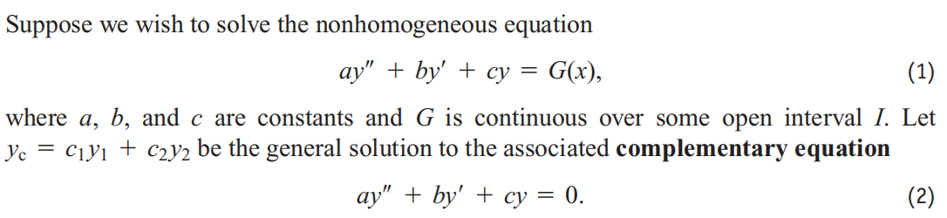
17.2 Nonhomogeneous Linear Equations
In this section we study two methods for solving second-order linear nonhomogeneous differential equations with constant coefficients. These are the methods of undetermined
coefficients and variation of parameters. We begin by
considering the form of the general solution.

Slide 2
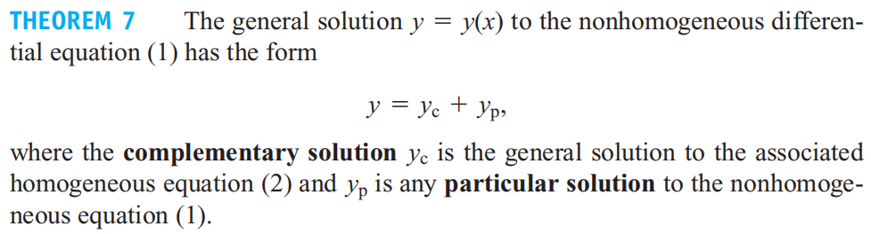
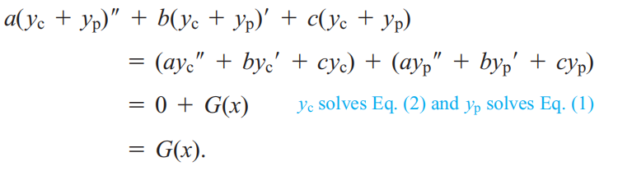
Proof：We first show that yc+yp is the solution of (1):

Slide 3
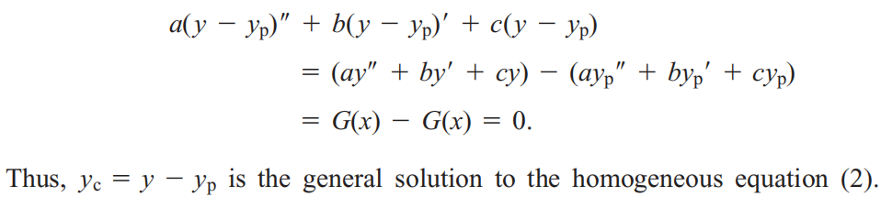
Secondly, We show that any solution of (1) can be represented
in the form of yc+yp: Suppose that y is the general solution of
(1), then

Slide 4
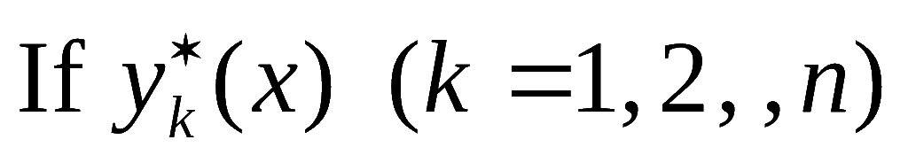
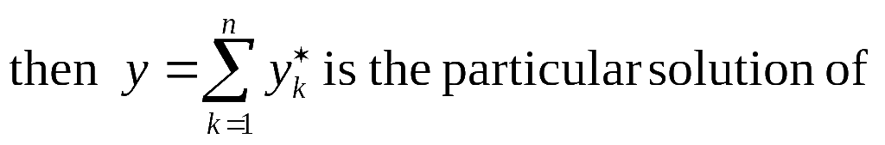
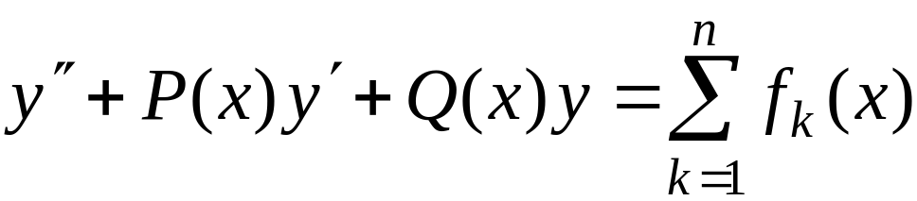
Theorem:
is the particular
solution of

Slide 5





Example: If are linearly independent
and all of them are solutions of
then the general solution of ODE is ( ).
Hints:
are the solutions of complementary equation and linearly independent.

Slide 6

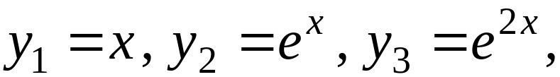


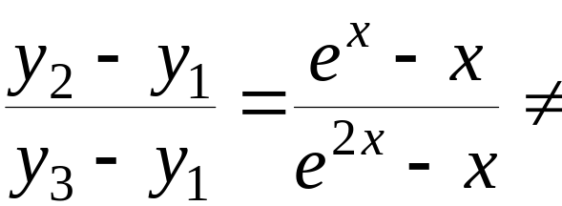
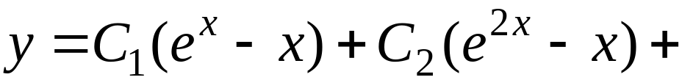


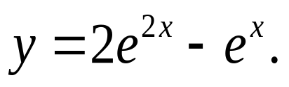
Example: If the ODE
has three different solution
Find the particular solution satisfying
Solution:
are the solutions of complementary equation, and
constant
therefore, they are linearly independent, and the general solution is
Substitute the initial condition into the above equation, we can find
Therefore, the particular solution is:

Slide 7

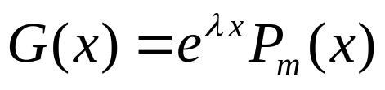
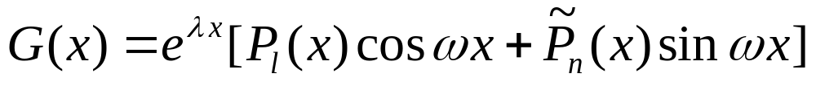
The Method of Undetermined Coefficients
The first type:
The second type:

Slide 8

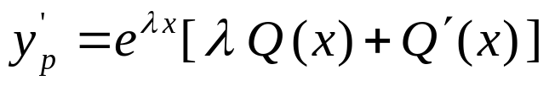
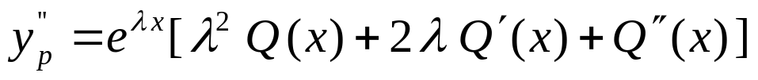
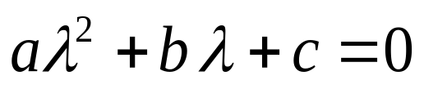
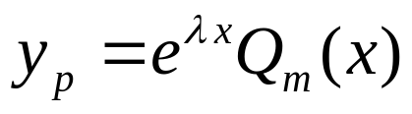
The first type:
Suppose the particular solution is , then
Substitue them into ODE, and combine terms
Case 1: λ is not the root of , then
where Qm(x) is a polynomial of degree m

Slide 9

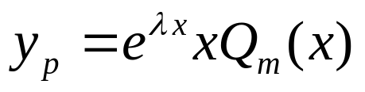

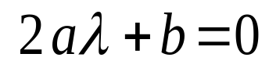
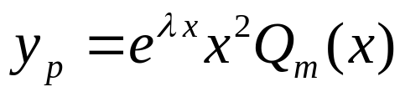
Case 2: λ is the root of with multiplicity 1 ,
then let where Qm(x) is a polynomial of degree m
Case 3: λ is the root of with multiplicity 2 ,
then let where Qm(x) is a polynomial of degree m

Slide 10
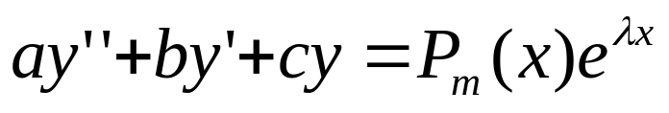
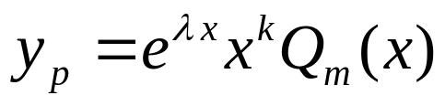
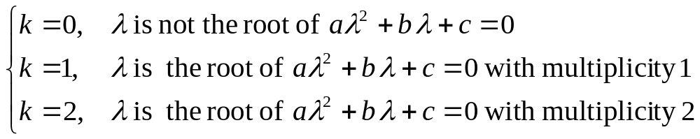
Summary: The form of particular solution of
is

Slide 11
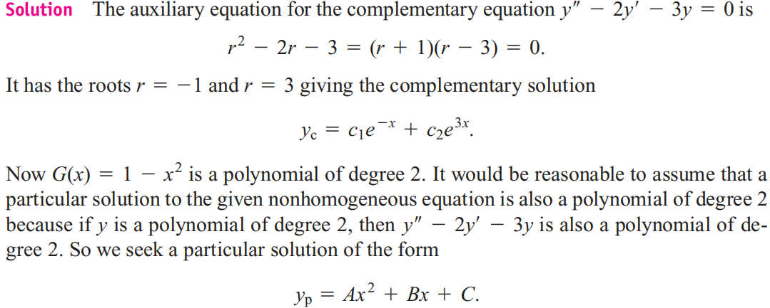
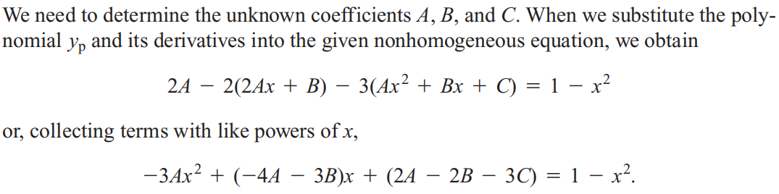

Slide 12
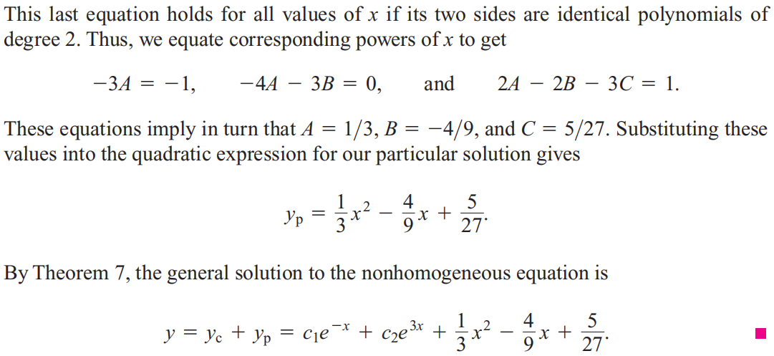

Slide 13
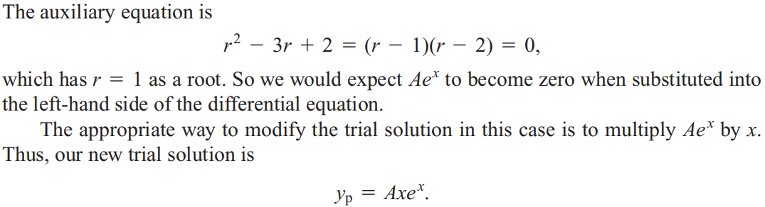
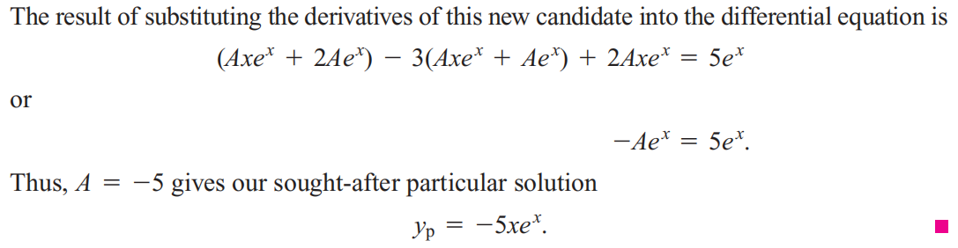
Solution:

Slide 14
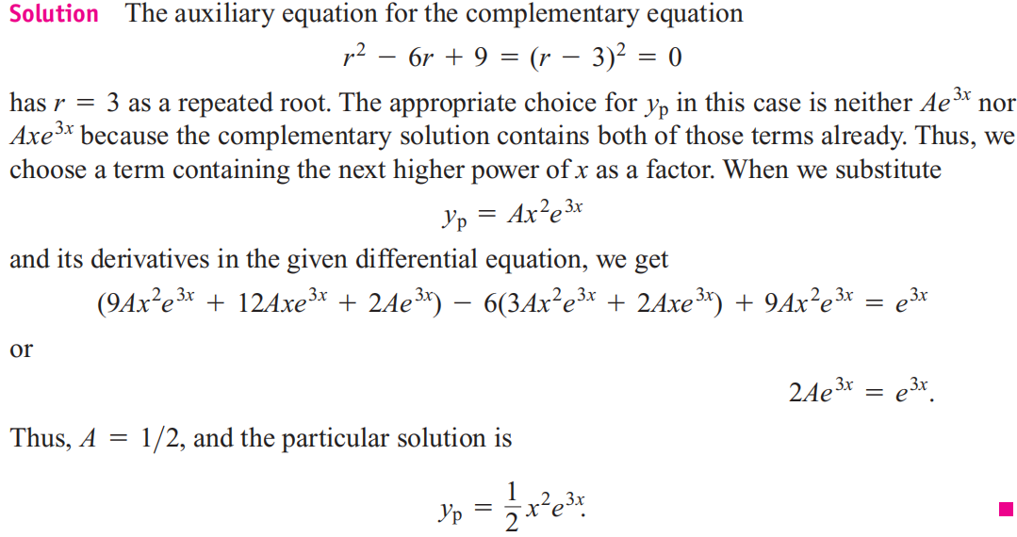

Slide 15
The second type:

Slide 16
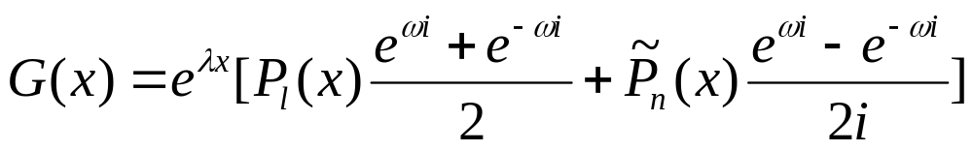
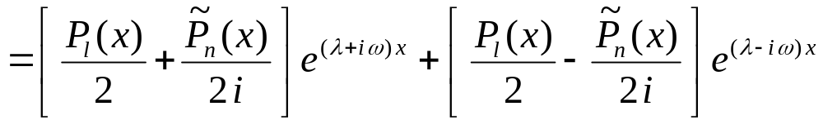

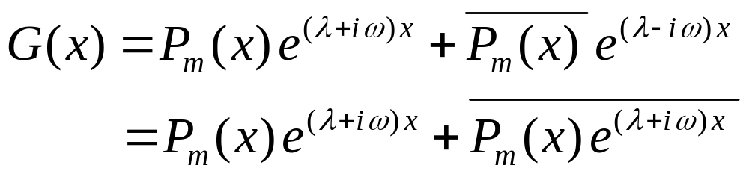
Step 1:

Slide 17
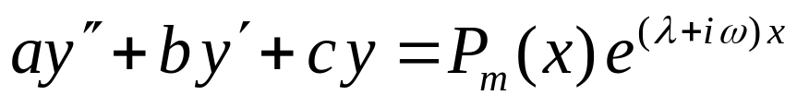
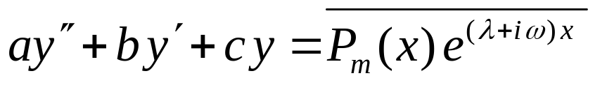

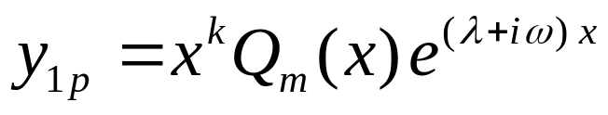
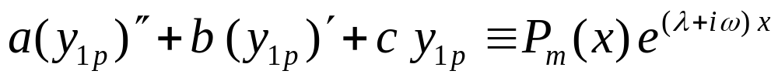
Step 2: Find the particular solutions of the following ODE
②
③
If is the root of auxiliary equation with multiplicity k, ( k = 0, 1), then the particular solution of ② is
then

Slide 18
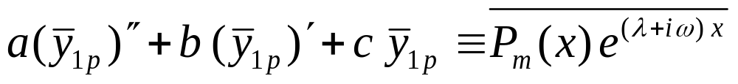

Take the conjugate of both sides:
the above implies is the particular solution of ③ .

Slide 19
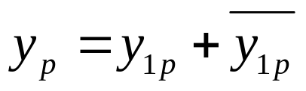
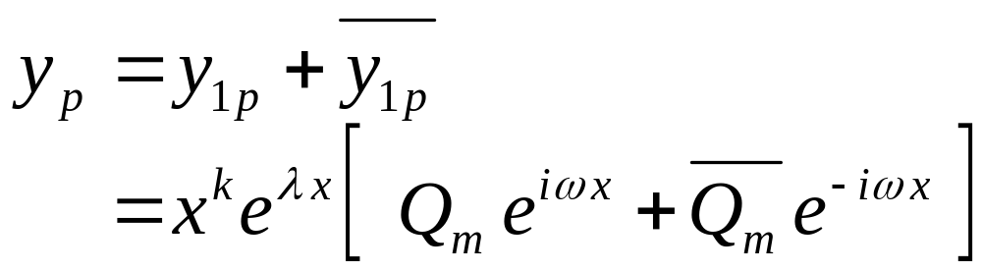
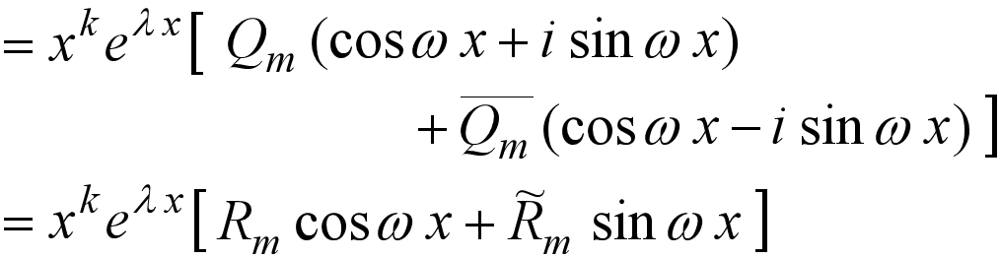
Step 3: Then the following ODE

Slide 20
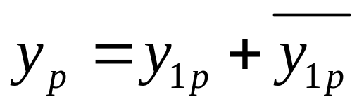
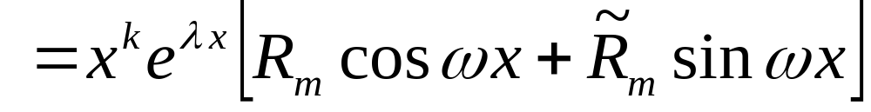
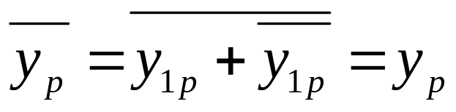
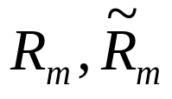
Step 4: Analyze
Since
then yp is a real function, therefore, should be real functions.

Slide 21
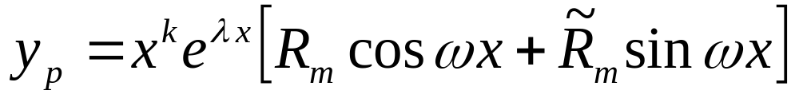

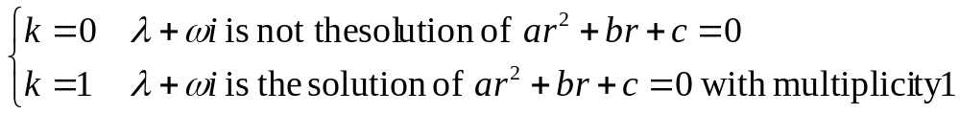
Summary:
For the non-homogeneous ODE
the particular solution is
where

Slide 22
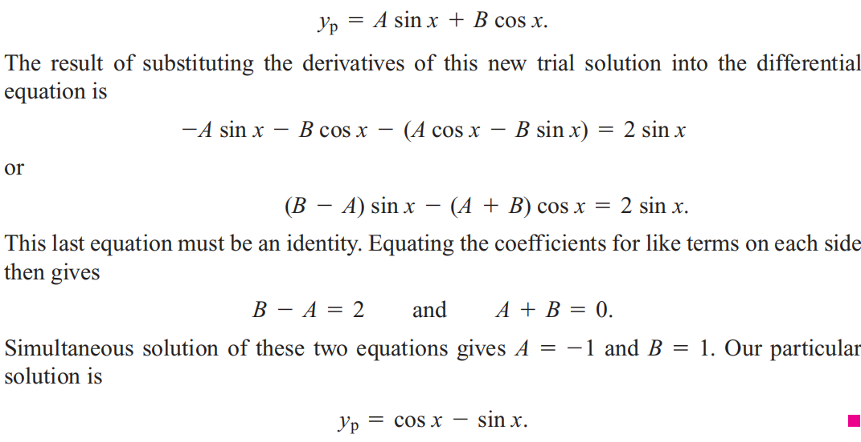
Solution: Since λ=i is not the solution of
auxiliary equation, then let

Slide 23
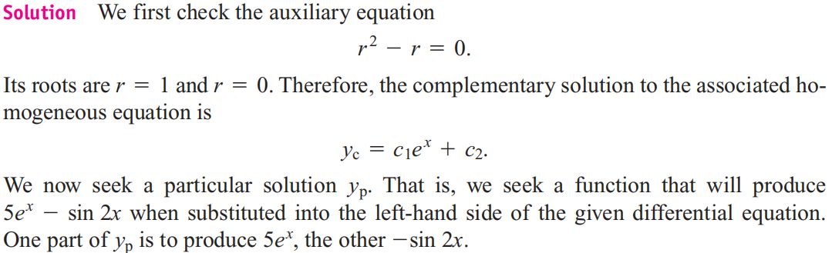
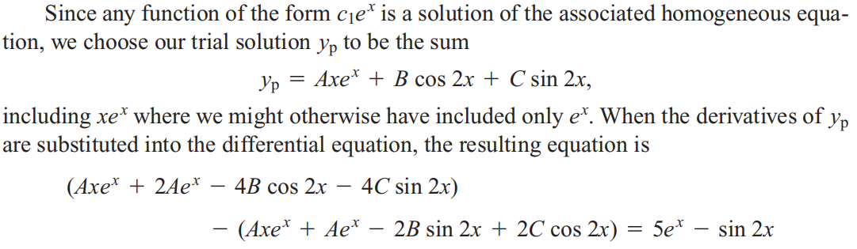

Slide 24
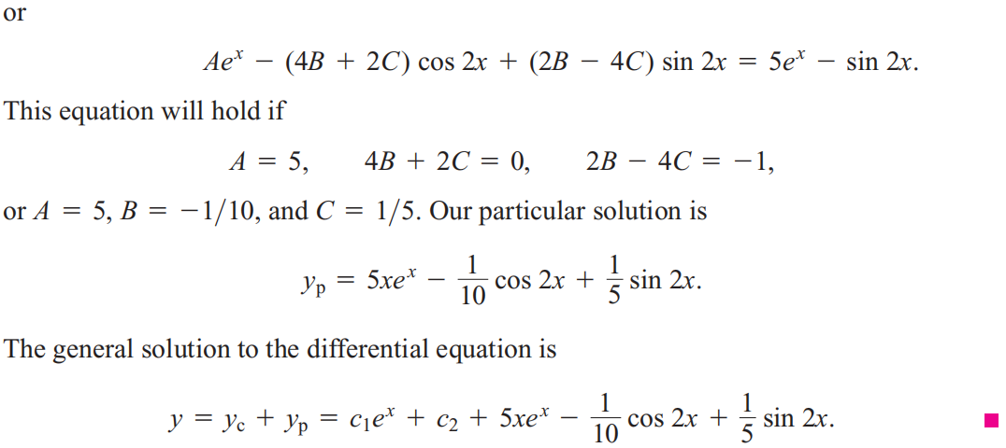

Slide 25


The Method of Variation of Parameters

Slide 26


Slide 27


Slide 28




Slide 29



Slide 30



Slide 31



Slide 32


Slide 33



Exercises：
1 . (Fill blanks) For the ODE
, then we can set the particular
solution is
, then we can set the particular
solution is

Slide 34

2. Find the function y=φ(x) satisfying

